Slide 1

Community Organizing & Family Issues (COFI)
Chicago based non-profit; founded in 1995
Our mission is to strengthen the power and voice of low-income and working families at all levels of civic life – from local institutions to the city, state and federal levels
We have trained and supported more than 3,400 low-income parent leaders, mainly mothers and grandmothers of color, in our Family Focused Organizing Model

Slide 2

Started out of the recognition that many parents – in particular low-income mothers and grandmothers of color – weren’t part of public policy decisions that affect their families
COFI believes:
  Parents are natural leaders as experts on their families and their communities
  Leadership starts from within
  Day-to-day struggles are often rooted in public policy, systems or practices
  Collective leadership
  Collaboration and partnership

Slide 3
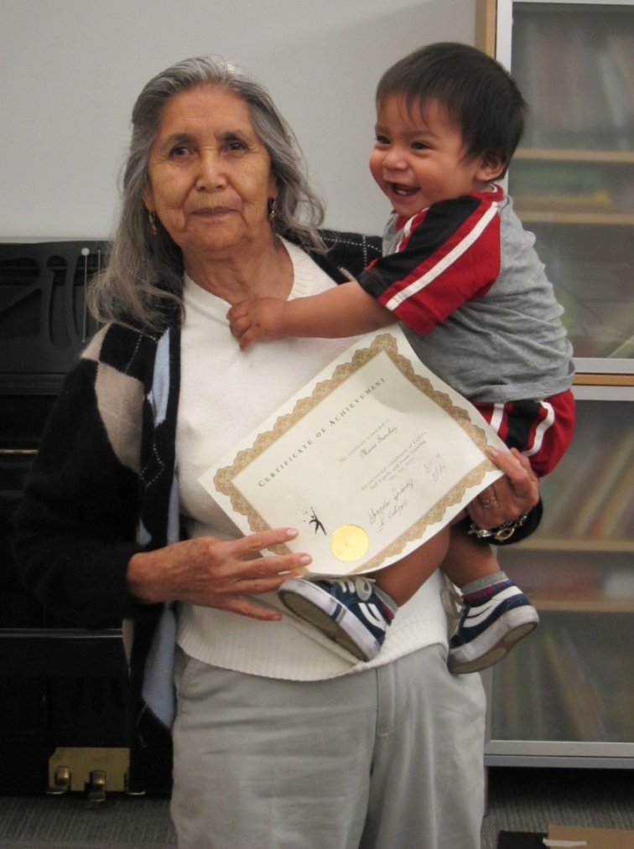
COFI’s Family Focused Organizing Model
PHASE 1: SELF, FAMILY & TEAM
Orientation and 6 wksps (2 hrs each)
Team Building Process (3-6 months)
PHASE 2: COMMUNITY OUTREACH
& ACTION
5 workshops (2 hrs each)
Outreach and Action (6-9 months)
PHASE 3: POLICY & SYSTEMS CHANGE Building a Parent Policy
Leadership Structure;
Ex: POWER-PAC, Parents Peer Trainers

Slide 4
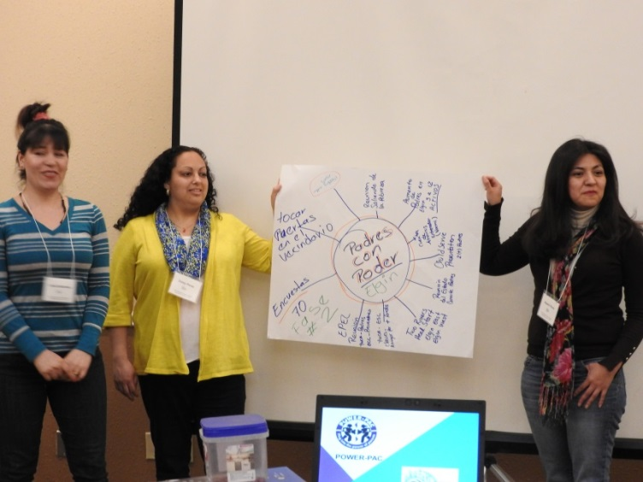
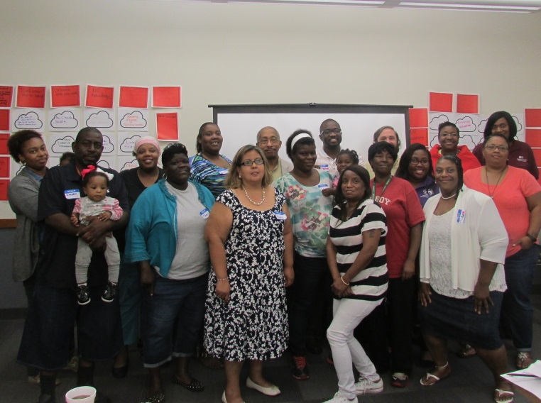
COFI’s Parent Engagement work with Early Childhood Collaborations
Aurora
Austin – Chicago
East St. Louis
Elgin
Englewood – Chicago
Evanston
Pilsen and Little Village – Chicago
West Chicago
Parents at collaboration tables
Parent-led efforts – Ambassador programs
Parents shaping policy

Slide 5
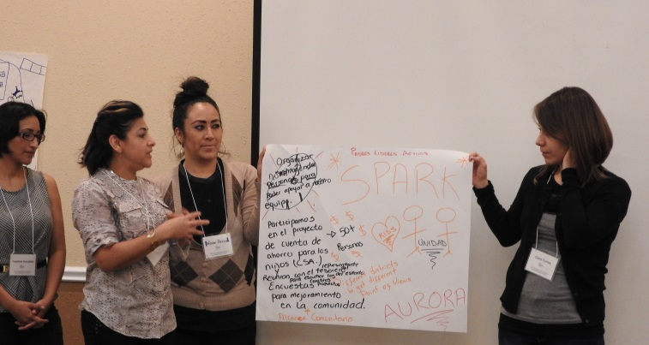
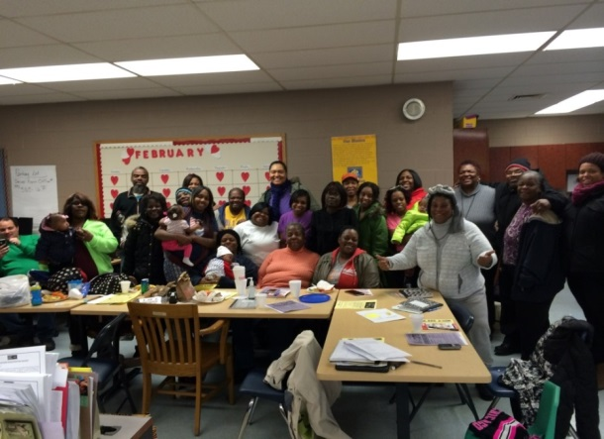
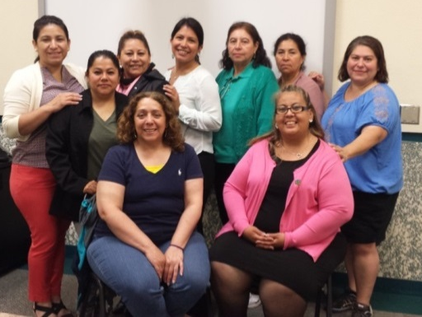
Parent Engagement Practices
Relationships - Develop relationships and trust with parents
Support - Provide parents with logistical support – childcare, refreshments, convenient meeting times, full translation, welcoming atmosphere and transportation
Decision-making role - Include parents in planning from beginning and incorporate their input
Parents leading/teaching other parents

Slide 6

Nohemi Perez – Parent Leader

Slide 7
Community Organizing & Family Issues (COFI)
1436 W. Randolph, 4th FL
Chicago, IL 60607
(312) 226-5141
www.cofionline.org
cofi@cofionline.org

