Slide 1
Observational Assessment and the Kindergarten Individual Development Survey (KIDS)
Illinois Birth Through 3rd Grade Continuity Conference
Tuesday, June 14, 2016
10:45pm - 11:45pm
Presented by: Lynn Burgett and Phyllis Bliven from ISBE
Amanda Dykstra from Valley View CUD 365-U

Slide 2

Who is in the room?
Notes:
Have participants raise their hands if: School Administrators, School District Staff, Head Start Staff, Community Leaders, Child Care, other?

Slide 3
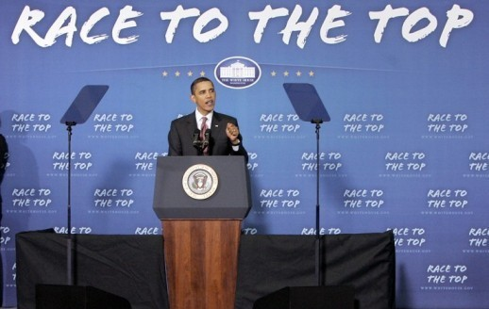
National Attention to School Readiness
Notes:
Thanks to Race to the Top funding, National attention was given to the need for school readiness data.
One of the criteria of the grant was for states to have a kindergarten entry assessment so that data could be used to:
Promote the success of every child
Help align the early childhood and elementary school systems
Measure child development across multiple domains of growth
Encourage collaboration between early childhood programs, elementary schools, and families to support students; transitions into kindergarten
Allow the state to respond to identified needs and,
Guide professional development for teachers and administrators

Slide 4
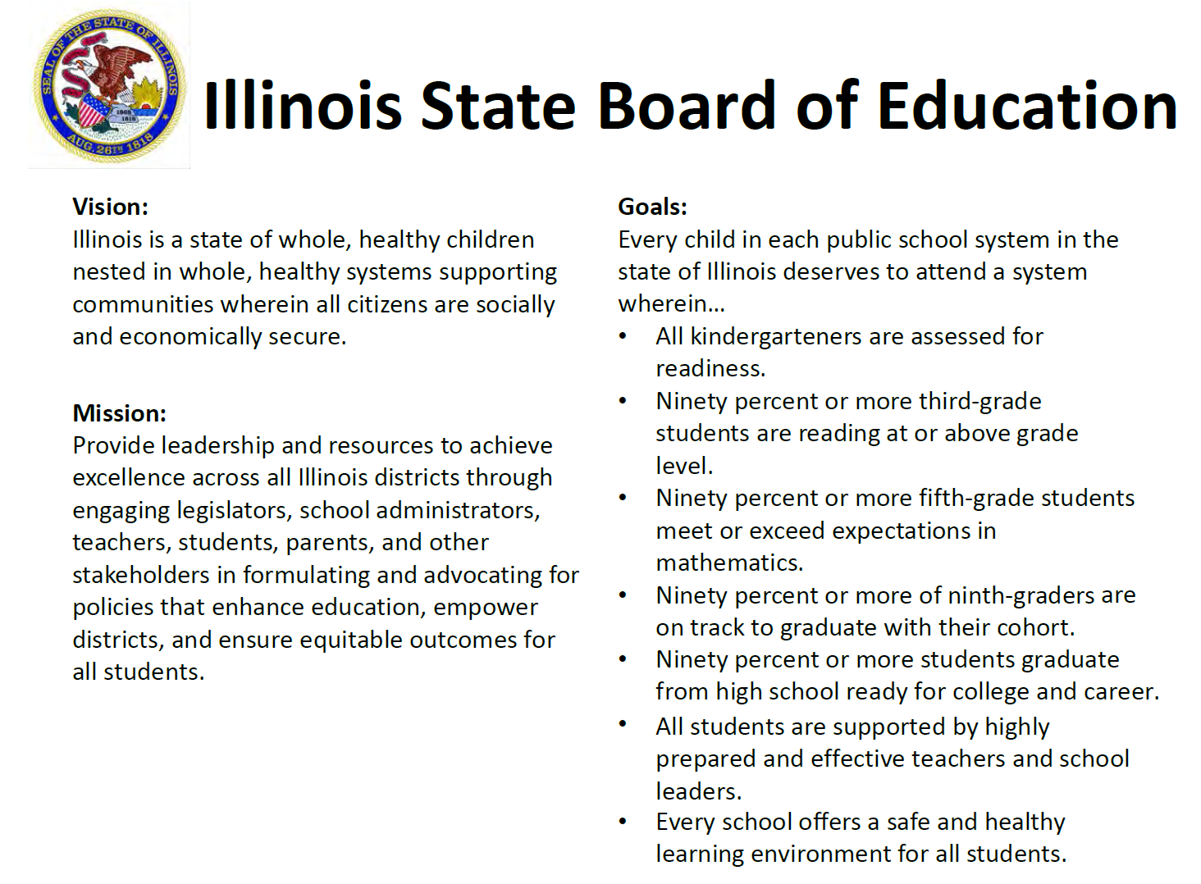
Notes:
In 2010, before Race To The Top, the State Board of Education recognized a need for school readiness data and put together a group of educators, advocates and experts to participate in a planning initiative to explore whether and how to adopt an Illinois Statewide kindergarten readiness assessment process.
As the process has evolved, the State Board has made kindergarten readiness a priority by including it in our state goals.

Slide 5

How will the state use the readiness data that is collected?
Inform policy changes for preschool and kindergarten
Help make appropriate funding decisions
Promote alignment between early childhood programs and elementary schools
Guide professional development for teachers and administrators
Notes:
The state needs reliable, consistent, readiness data in order to respond to identified needs. The data can help identify areas that have a lack of high quality programs for our most at-risk children, it will help promote best practice in kindergarten by more closely aligning it with early childhood programs, and will help guide professional development for teaches and administrators.
Basically, the data should allow the state to funnel resources to the areas most in need, in order to insure that every child in Illinois has an equal opportunity to be ready for school and later success in college and/or their chosen career.

Slide 6
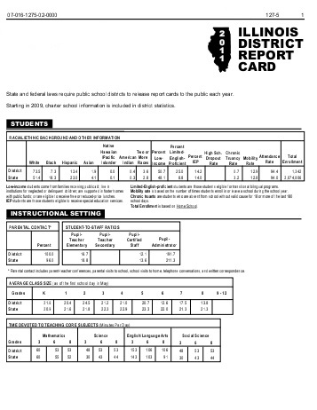
Illinois School Report Card
Notes:
Each district receives a district report card as well as individual school report cards. It is in the works to include the kindergarten/school readiness data gathered through KIDS, on the elementary school report card.

Slide 7

Each child enters kindergarten with a wide variety of birth-to-five experiences.
Home care
Child care center
Private preschool
Head Start
Preschool for All
Special Education services
Notes:
Read the slide and then… Children also enter kindergarten with an even wider array of developmental strengths and needs.

Slide 8
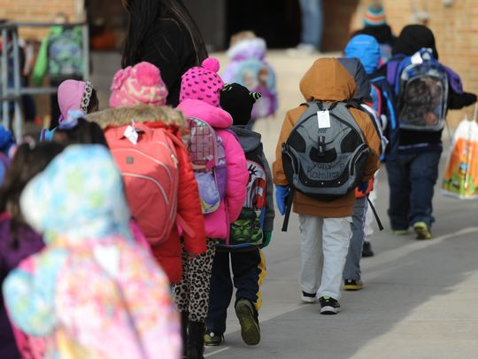
Why not collect readiness data in preschool?
Not all children attend a state funded preschool program, where state data could be collected.
98% of eligible kindergarten students do attend kindergarten
Notes:
In most states across the country, including Illinois, kindergarten provides the first universal access point to public education. By waiting until 3rd grade to collect this type of data we have missed opportunities to address achievement gaps for at risk students. Even though kindergarten is not mandated in Illinois, 98% of children who are eligible to attend, do attend. This is why it has been proposed that this type of data be collected in kindergarten as apposed to preschool.

Slide 9
Preschool For All (PFA) assessment requirements:
Item 12 on the Compliance Checklist states:
The program utilizes an appropriate research-based authentic assessment system that aligns with the curriculum and documents children’s progress over time with measurable outcomes.
Portfolios
Regular ongoing observations of children in typical daily classroom activities
Aligned to the Early Learning and Development Standards
Research-based developmental checklist that measures progress over time
Summary report that is shared with parents.
Notes:
Number 12 on the preschool for all compliance checklist states the assessment requirements for the state’s PFA and preschool expansion grants.
Research-based authentic assessment system which includes:
Portfolios
Regular ongoing observations of children in typical daily classroom activities
Aligned to the early learning and development standards
Research-based developmental checklist
Summary report to share with parents

Slide 10
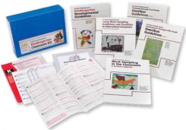


Examples of research-based assessment systems that meet these requirements:
Notes:
Work Sampling System
Teaching Strategies GOLD
Early Learning Scale

Slide 11
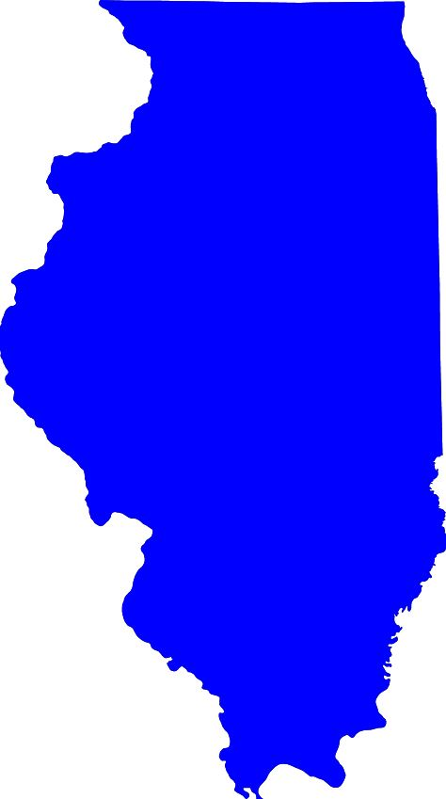


Kindergarten Individual Development Survey (KIDS)
NOT a paper-and-pencil assessment
Measures school readiness across various developmental domains
Based on classroom observations of the child during everyday classroom activities and behaviors
Ongoing throughout the school year
Three rating periods; fall, winter, and spring
Notes:
California’s Desired Results Developmental Profile (DRDP) is a developmental continuum from early infancy up to kindergarten entry which measures child progress toward desired outcomes. The Kindergarten Individual Development Survey (KIDS) was adapted from the DRDP. KIDS is a formative assessment designed for teachers to observe, document, and reflect on the learning, development, and progress of all children during the kindergarten year.

Slide 12

The KIDS rating system is made up of 11 domains:
Approaches to Learning-Self-Regulation
Social and Emotional Development
Language and Literacy Development
English-Language Development
Language and Literacy in Spanish
Cognition: Math
Cognition: Science
Physical Development
Health
History-Social Science
Visual and Performing Arts
Notes:
KIDS assesses 11 development domains, however, research has shown that knowledge/skills in the red-colored domains have the greatest impact on later school success.

Slide 13

WSS-IELDS-KIDS Assessment Continuum
Notes:
The Center for the study of education policy at Ill State University is in the process of developing assessment continuums which show how measures are aligned between the assessments that most PFA programs are using (those listed on the previous slide), the early learning and development standards and the KIDS rating system.
Example:
Work Sampling System = I.C.1 Shows eagerness and curiosity as a learner
Early Learning and Development Standards = 30.c Demonstrate skills related to successful personal and school outcomes
KIDS Measure = Approaches to Learning-Self-Regulation: Curiosity and Initiative in learning

Slide 14
What is already being done?
New Jersey:
New Jersey Kindergarten Implementation Guidelines
New Jersey Department of Education First through Third Grade
San Francisco:
The Power Of A Good Idea
The National Association of Elementary School Principals
Leading Pre-K-3 Learning Communities - Competencies for Effective Principal Practice
Washington State:
Washington State Early Learning and Development Guidelines - Birth through 3rd Grade
Notes:
As we think about aligning our early childhood teaching, learning, and assessing with kindergarten, 1st, 2nd, and 3rd grade, we can look to see what other states are already doing.
New Jersey first created a kindergarten implementation guidelines manual, and then extended the developmentally appropriate guidelines to a 1st through 3rd grade manual
In San Francisco they released a report in June of 2015 describing the process they have implemented for building alignment between PreK, 3rd grade and beyond.
The National Assoc. of Elementary School Principals developed a document giving guidance on creating a an early learning continuum through 3rd grade.
Washington State has aligned and developed early learning and development guidelines fro birth through 3rd grade.

Slide 15
Where is Illinois in the process of implementing KIDS?
Must Do’s: All kindergarten teachers trained 14 measures within 4 of the readiness domains. Reported in KIDStech after the first 40 days of enrollment . Readiness data reported beginning with FY18 | Can Do’s: Collect measures or whole domains in addition to the measures required Enter ratings for winter and/or spring assessment windows as well as fall Use the KIDS assessment framework to create a supplementary parent report or as part of their standards-based report card.
Notes:
One of the purposes of collecting the KIDS data is to promote alignment between early childhood programs and elementary schools. It is one of the first efforts to create developmentally appropriate assessment practices between preschool and kindergarten.
The new state requirements will be 14 measures located within Approaches to Learning-Self-Regulation, Social/Emotional, Math, and Language and Literacy domains, reported in KIDStech after the first 40 days of K enrollment. This will begin with FY18
Although these are the minimum requirements, there are many things that districts may choose to do beyond the minimum.
Next Amanda will give you some information about how they are using KIDS at Valley View to promote best practice and alignment between pre-k and the early elementary grades.

Slide 16
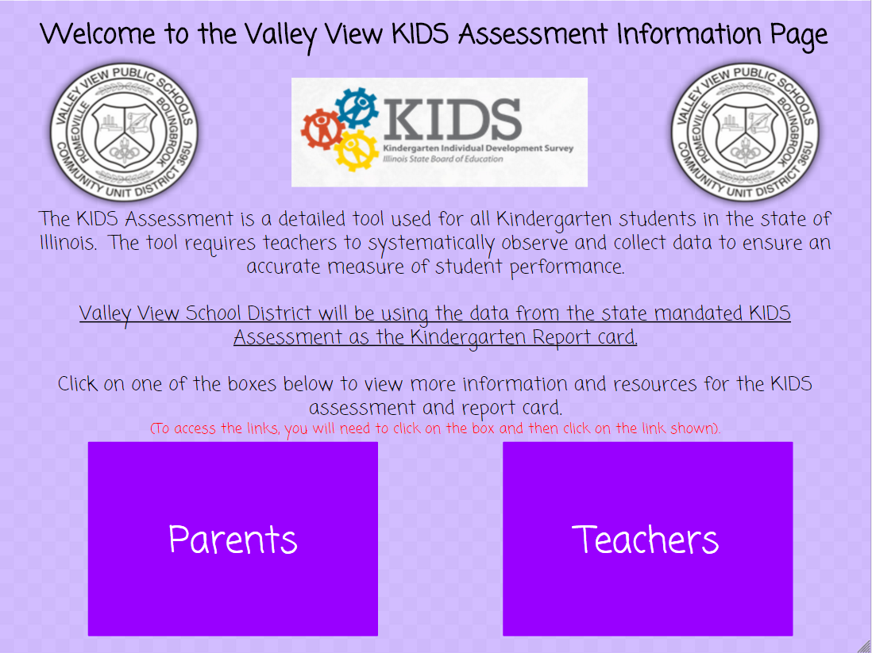
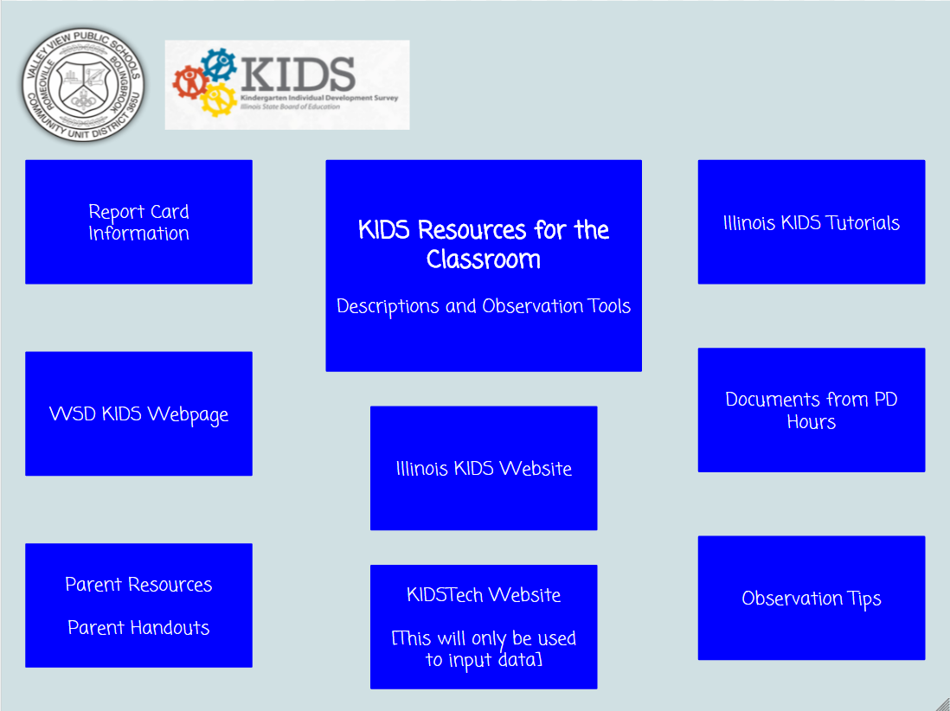
Valley View KIDS Implementation
Teachers
Notes:
Book Study – The Power of Observation Birth-8 – Judy Jablon
2 day KIDS Training
Collaboration time with peers
Website

Slide 17
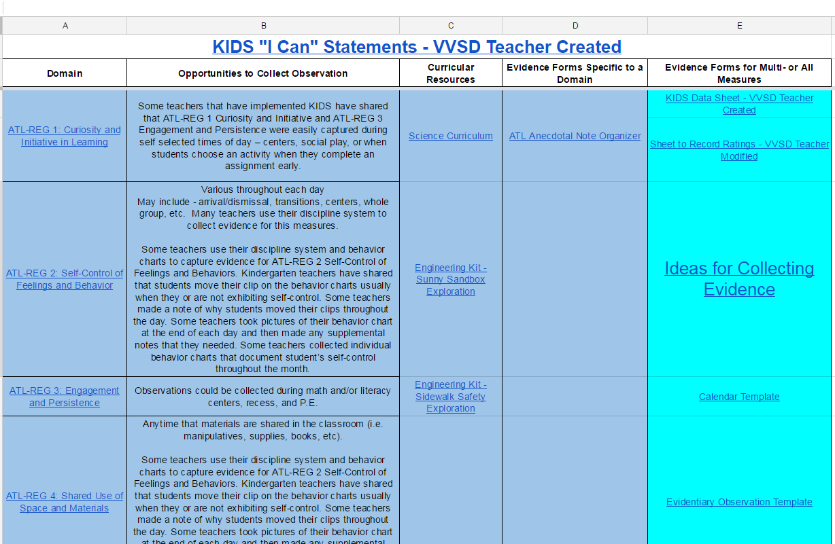
Valley View KIDS Implementation
Curricular Resource Alignment

Slide 18


Valley View KIDS Implementation
Trainings
Pinterest Board – VVSD PreK-5 Elementary Curriculum
Notes:
Trainings on Play-Based instruction with PreK-1st grade teachers
- Teams are now having conversations with 1st grade teams about what instruction looks like in kindergarten
Pinterest Board for Resources

Slide 19
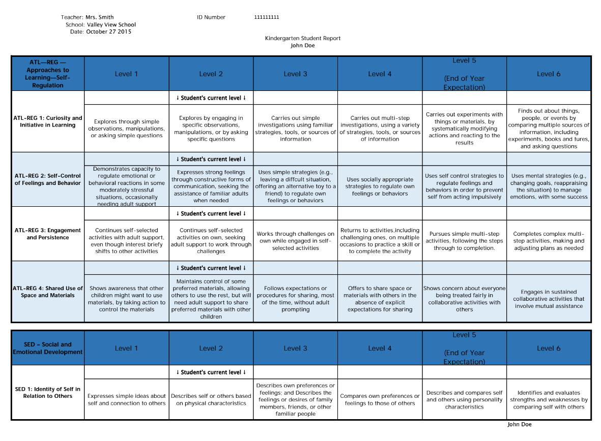
Valley View KIDS Implementation
Report Card

Slide 20
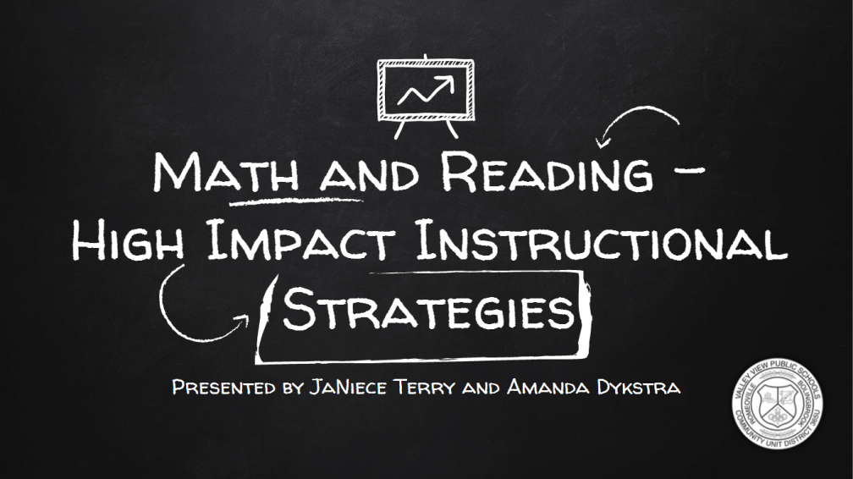

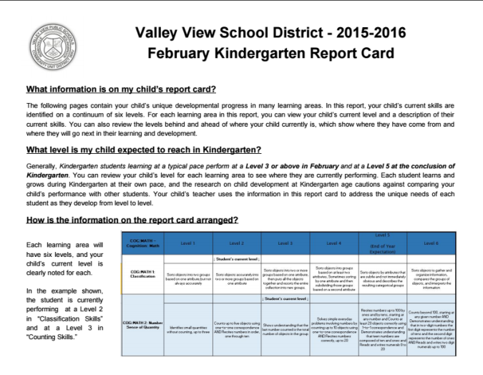
Valley View KIDS Implementation
Administrators
Notes:
KIDS Admin training
Instructional Practices that align with developmentally appropriate instruction with reflective questions to ask
Collaborative Walk-throughs discussing instructionally appropriate practices.
Provided communication with report cards

Slide 21
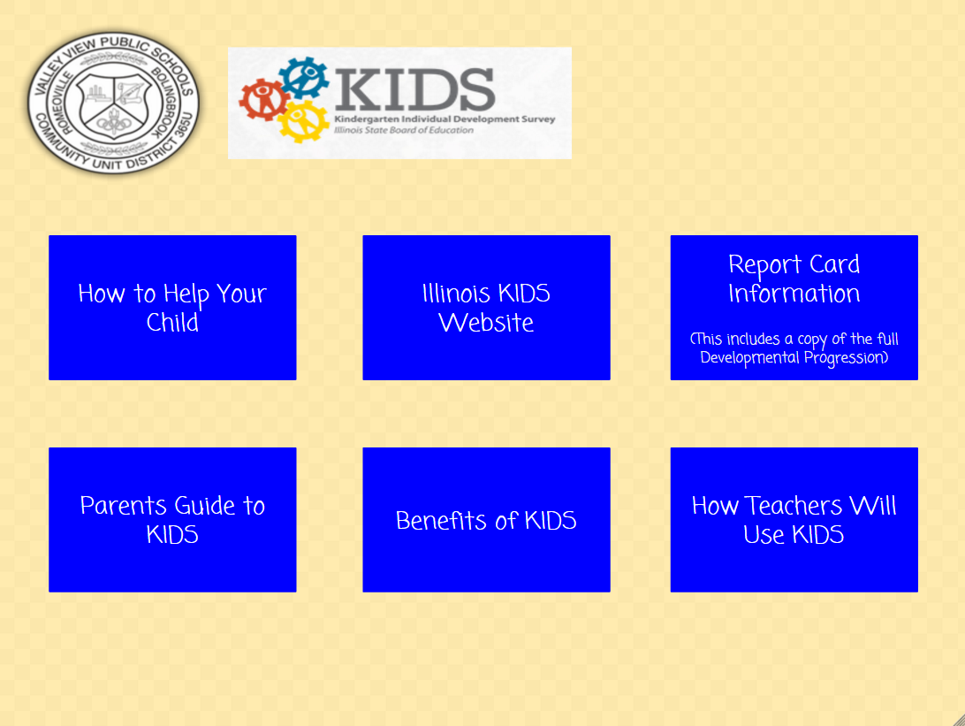
Valley View KIDS Implementation
Parents
Notes:
Website
How to help your child sheets
Report card examples and explanation
Community Forum to Answer Questions

Slide 22
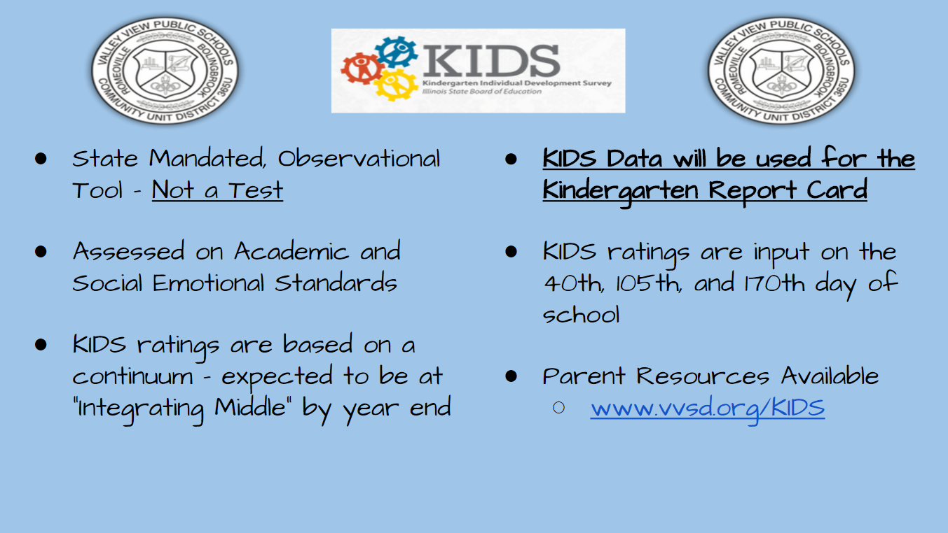
Valley View KIDS Implementation
Parents
Notes:
Curriculum Night and Parent Teacher Conferences
Report Card changed due to parent feedback (show entire continuum, levels)

Slide 23
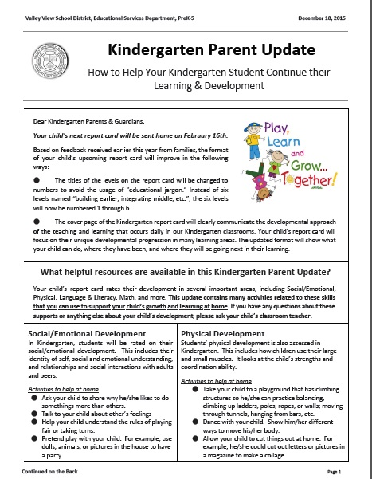
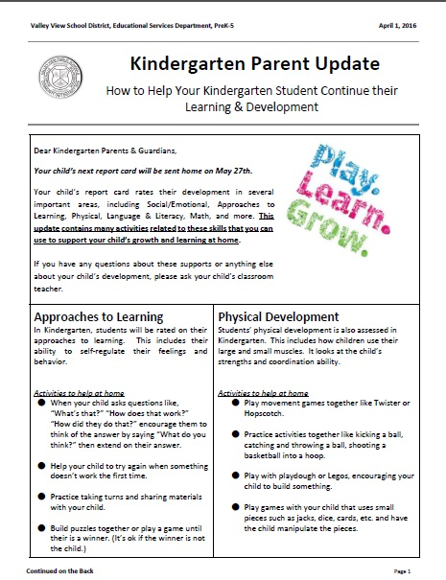
Valley View KIDS Implementation
Parents
Notes:
Communication between rating periods

Slide 24
Valley View KIDS Implementation
“Utilizing the KIDS assessment has brought new successes into my classroom. My focus has shifted from purely academic achievement to looking at each child as a whole. I am able to get to know every child more fully, and I am able to allot time to facilitate social-emotional growth without feeling as though I am neglecting the curriculum. I have made more time for play-based activities and my students are happier and more eager to do academic tasks when asked.”
Micaela Boness, Kindergarten Teacher
“I find out a lot about my students. We’re [Guillermo’s kindergarten team] all excited because it’s helping them [the students] think more. It especially focuses on the social skills. I used to give them [the students] what I was thinking and it was frustrating to me. Now I tell them they are the experts and you tell me what you know. This builds their writing.”
Guillermo Hinojosa, Kindergarten Teacher

Slide 25

Questions, Comments, Feedback??
Thank you for your attendance and participation!
Notes:
Any questions, thoughts, comments, insights?

