Slide 1

Community Schools:
What, Why and How
Notes:
First some background on the Federation – the Federation for Community Schools is a state-wide organization dedicated to changing public policy to support community schools, identifying funding to support community schools, and providing resources and supports to develop highest-quality community schools across Illinois.

Slide 2
The federation for Community Schools
A statewide collaborative that amplifies the voice and abilities of community schools.

Slide 3
Part of a movement
Nationally
In Illinois
Coalition for Community Schools
More than 2000 community schools around the country
Networks forming in CA, NY, OH, MI and IN
Federal legislation
Largest number of community schools in any state
17 communities, more than 200 community schools
Supportive policy at the state level, supportive Federal officials

Slide 4
What is a community school?
By bringing together public schools, non-profit organizations and local businesses community schools provide a broad range of programs and services to students and their families in support of comprehensive child development.
Through this approach, community schools become the center of their communities, and create an environment where students and their families can reach their full potential.

Slide 5
A strategy…not plug-and-play
Looks different across and within communities
Unique families, unique needs, unique assets
Importance of shared vision, clear goals
Notes:
MELISSA
Both because the work is “organic” and funded in many different ways ranging from Teen REACH, private grants, school district funds, 21st CCLC dollars, afterschool tuition dollars, other Federal money, etc., community school work is called a lot of different things.
Oftentimes I speak with people about the model, and at first they’re pretty clear they aren’t going that work, but once we get into the “meat” of it, they identify the elements of their work that hook into the model.
Basically, I don’t particularly care what it’s called – I care that the work is getting done, and that schools, community partners and families are working to support student and adult development.
What we AREN’T talking about when we talk about community schools are neighborhood schools—those that serve the students in a particular area.

Slide 6
outcomes
Improved attendance and grades
Positive changes in school climate and culture
Sustained structure for connecting communities, families an schools
Overcoming barriers to learning and development
Access to opportunities all children need to succeed and thrive

Slide 7
Baltimore framework
Notes:
** After you go through this slide, we’ll give partners a couple minutes to silently walk around the room and look at the works of vision that were done previously and which we’ll lay out for them to look at. For now they are just observing. We will do further discussion of this a bit later.

Slide 8
ABCS of
Community Schools
A school makes the transformation into a community school by implementing the ABCs:
Aligning partners & programming
Bringing together all stakeholders
Coordinating community resources
Notes:
** After you present the slide, Sarah or Alex will talk about how our transformation took place. I.e. WeGo Together for Kids.
How does this work look?
At a basic level, community schools work because they implement the ABCs –
Align OST programming with classroom learning
Bring together all stakeholders, working towards common goals
Coordinate resources to meet identified needs and maximize existing investments in community-based resources

Slide 9
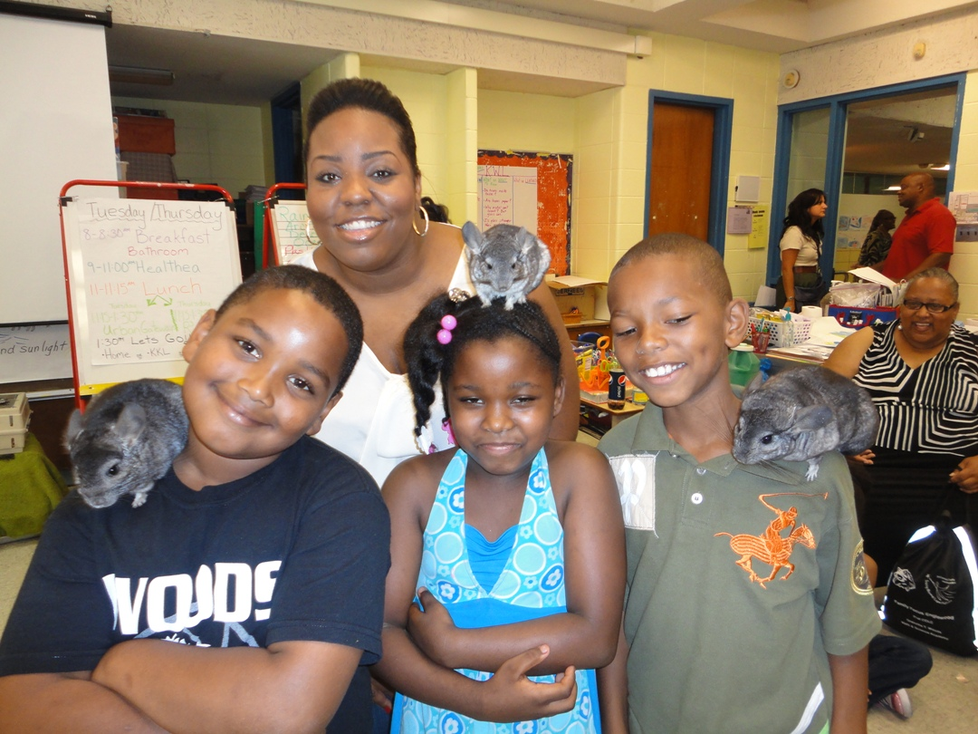
Aligning
Partners & Programming
In a community school, out-of-school-time programming aligns and complements—but does not replicate--school-day learning
Notes:
** We might add that conversations are yet to be had because of the fact that we went about it “typical “ manner. Those conversations with school-day staff are still in the making.
A community school provides a full range of programs that support the development of the whole child by aligning these programs to in-school day curriculum.
Out-of-school time programs that are linked to classroom learning provide additional opportunities to master necessary skills or gain new experiences that make students lifelong learners.
Provide opportunities for students to practice skills in ways that are not provided during the day.

Slide 10
Bringing
Together Stakeholders
    Community schools bring together stakeholders to work towards a common goal and shared vision of student success
    school administrators and staff
    parents and family members
    community-based organizations and
    community members
    local business leaders
    local political leaders/elected officials,
    students
Notes:
** Again, we might add that these conversations are still in process. Many of these stakeholders are at the table, but several are not.
A community school brings together all of the stakeholders who play pivotal roles in students’ success in school and life.
By working together towards one common goal (or shared vision)– the success of children – stakeholders drive the transition from a school into a community school.
One example of how these stakeholders are organized to work together is through the community school advisory board.
Broad representation from the school, community, and families.

Slide 11
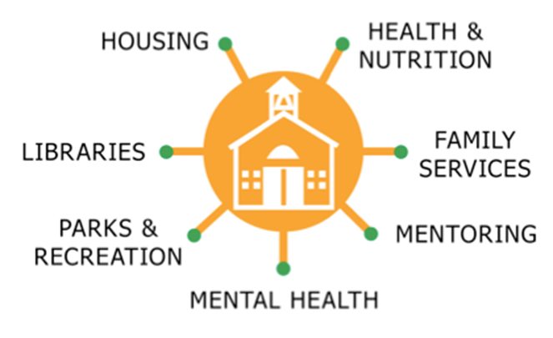
Coordinating
Resources
  Community schools have a dedicated person responsible for building and managing community resources in the school building.
Notes:
There are many resources available to support the successful growth and development of children – but these resources are often scattered, and go either under-utilized or un-utilized.
The community school’s director serves the function as a resource coordinator, identifying needs and linking the resources in the community to the students, parents, and community members that need them most.
Community schools coordinate the access to necessary resources by creating meaningful partnerships and linkages between the school and community-based organizations and resources.
This coordination means that previously un-or-under-utilized resources are brought to bear on student and adult needs, thereby maximizing existing investments in community-based supports.
I also look at this part of the work as being critical to ensuring strong transitions for students and families – how are community schools creating intentional connections to early learning? Ensuring that the youngest members of families are connecting to early learning opportunities?

Slide 12
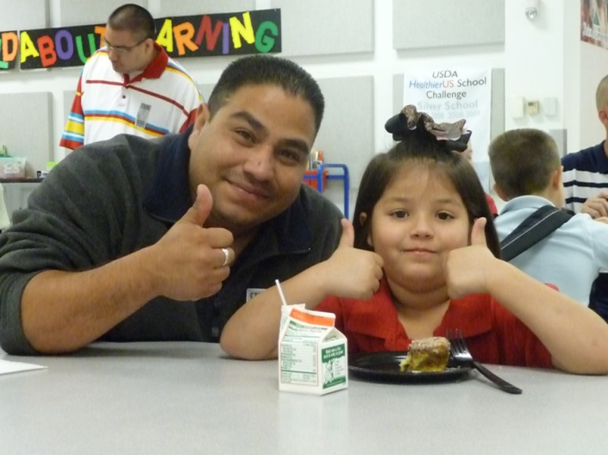
What kinds of supports?
Depends on what’s needed…
Health/wellness
Access to benefits
Crisis intervention
Leadership development
Adult education
Weekend backpacks
Tutoring
…but it’s not a prescribed list of programs – it’s a strategy for coordinating and aligning supports.
Notes:
CRISIS – GARFIELD/TREWYN
Focus is on comprehensiveness of services – not one-off (usually), not “plug and play,” but a coordinated effort to weave together the supports necessary to address the complex challenges that students and families face.

Slide 13
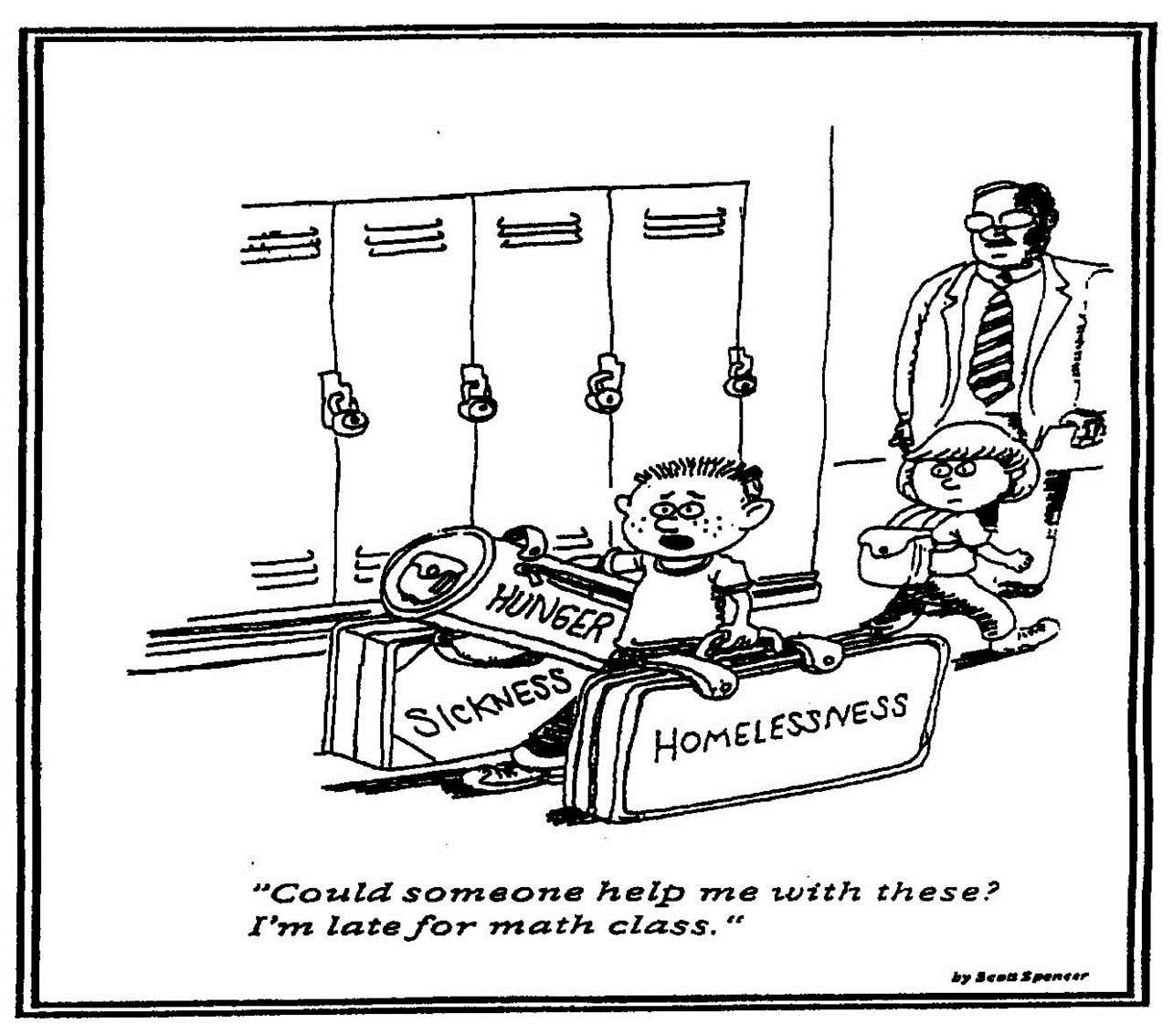
Why a community school approach?
Why….?
What are we asking of schools?
What are we asking of students?
Notes:
Why is it important?
What are we asking schools, teachers, students to do?
Think it through – how effective would any of us be as teachers? As learners? What if YOU were expected to know how to do absolutely everything that any job in your organization requires….? Without any support?

Slide 14
Shared vision
Common definition of success for children and families in our community
Agreed-upon goals and outcomes
Aligning partnerships, programs and services with goals and outcomes
Vision owned by all stakeholders

Slide 15
Resource coordinator
Not one person who “owns” programs
Ensuring that partnerships are coordinated and aligned – and that structures are in place to support them
Promoting shared leadership, data-driven decision making
Bridge among families, schools and partners
If a community school is a symphony, the Resource Coordinator is the conductor

Slide 16
Resources
Federation for Community Schools tools and resources
www.ilcommunityschools.org
The Coalition for Community Schools
www.communityschools.org
Notes:
MELISSA
Upcoming trainings, get involved, sign up for our newsletter
Coalition conference April 4-6

Slide 17
Contact Information
Federation for Community Schools
33 W. Grand, Suite 300
Chicago, IL 60654
312.836.0854
www.ilcommunityschools.org
Melissa Mitchell
Melissa@ilcommunityschools.org

