Slide 1
ROE 17 & ISU: A Partnership for Learning

Slide 2
Council for Teacher Education (CTE)
Arts and Sciences
Applied Science and Technology
Business
Education
Fine Arts

Slide 3
Cecilia J. Lauby Teacher Education Center

Slide 4
What is the edTPA?
National performance based assessment of teaching
Developed by the Stanford Center for Assessment, Learning, & Equity (SCALE) in conjunction with…
AACTE (both national and state chapters)
Over 1,000 educators in 29 states
Over 450 institutions of higher education

Slide 5
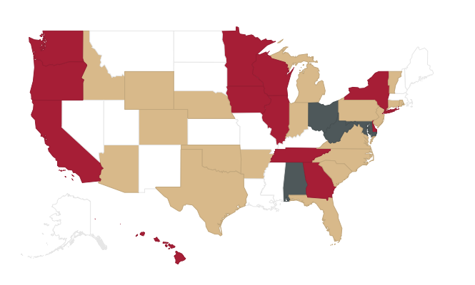
National Participation in edTPA
Notes:
622 educator programs in 35 states
Red = policy in place
Blue = taking steps toward implementation
Tan = some participation

Slide 6
ISU & edTPA
Spring 2011 2013 – 11 ISU programs pilot the edTPA
Fall 2013 – Spring 2015
Full implementation of edTPA for all programs (in compliance with state legislation)
Provost’s office provides funds for official scoring of edTPA portfolios
Consequential for program completion and licensure on September 1, 2015

Slide 7
What do student teachers need to do for the edTPA?
Create a portfolio of evidence of practice centering around 3-5 lessons (learning segment)
Explain and justify their instructional decisions
Build a case that they are ready for their own classroom

Slide 8
Structure of edTPA

Slide 9
Planning Task
Key Teaching Constructs
Planning for content understanding
Supporting varied student learning needs
Using knowledge of students to inform teaching and learning
Supporting language demands
Monitoring and supporting student learning
What’s Submitted?
Context for Learning
Planning Commentary
Lesson plans
Instructional materials
Assessments

Slide 10
Instruction Task
Key Teaching Constructs
Learning Environment
Engaging Students in Learning
Deepening Student Learning
Subject-specific Pedagogy
Analyzing Teaching Effectiveness
What’s Submitted?
Video clip(s)
Instruction Commentary

Slide 11
Assessment Task
Key Teaching Constructs
Analyzing Student Learning
Providing Feedback to Guide Learning
Guiding Student Use of Feedback
Analyzing Students’ Use of Language
Using Assessment to Inform Instruction
What’s Submitted?
Assessment Commentary
Student work samples
Evidence of feedback
Evaluation criteria

Slide 12
Table Talk #1:
How do the edTPA and Danielson’s Framework for Teaching relate to each other?
Resources:
Structure of the edTPA
Guide to the edTPA Rubrics
The Framework for Teaching

Slide 13
edTPA Rubric Blueprint
Task name: Rubric Title Guiding Question
Level 1 | Level 2 | Level 3 | Level 4 | Level 5
Struggling candidate, not ready to teach | Some skill but needs more practice to be teacher-of-record | Acceptable level to begin teaching | Solid foundation of knowledge and skills | Stellar candidate
Notes:
Rubric Progressions: Early novice to expert teacher
Candidate demonstrates:
Expanding repertoire of skills and strategies
Deepening of rationale and reflection
Shift from teacher focus to student focus
Move from whole class to generic groups to individuals

Slide 14
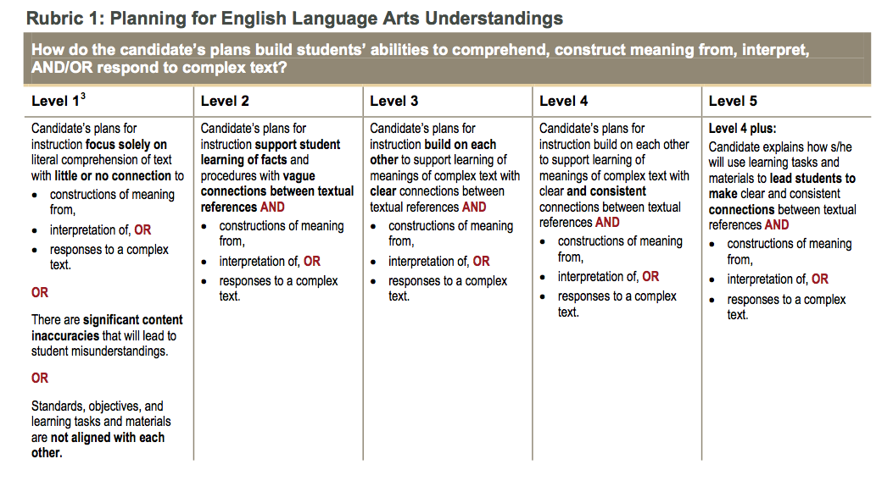

Slide 15
edTPA Scoring
5 Rubrics
5 Rubrics
5 Rubrics

Slide 16
Passing Scores in Illinois
2015 - 16: 35
2016 - 17: 35
2017 - 18: 37
2018 – 19: 39
2019 – 20: 41

Slide 17
Table Talk #2
Analyzing ISU’s edTPA performance
What areas of strength do you see in the data? Why do you think student teachers are performing well in those areas?
What are the areas of challenge you see in the data? Why do you think student teachers are struggling in those areas?
Tools
Guide to the edTPA Rubrics
Spring 2015 ISU edTPA Scores

Slide 18
Impact of edTPA on ISU
New capstone assessment
Common language
High stakes assessment tied to student teaching
Requirement for program completion
Development of edTPA retake support system
Revision of university and program assessment systems
Need for extensive faculty professional development

Slide 19
Impact of edTPA on Student Teachers
Extensive 10 – 12 week project
Emphasis on certain teaching practices
$300 fee
More extensive reflections
Better preparation for teacher evaluations

Slide 20
General Timeline during Student Teaching
Weeks 1 – 6: Work on Task 1
Weeks 7-8: Teach learning segment
Weeks 9-12: Complete Tasks 2 & 3
Week 13 or 14: Submit for official scoring

Slide 21
Impact of edTPA on Cooperating Teachers
Student teacher may be brought back to ISU more often for workshops
May be asked to assist with…
Distributing and collecting video permission forms
Helping the student teacher find a place in the curriculum that may be a good fit for the learning segment
Video recording

Slide 22
Impact of edTPA on the Profession
Introduction of “culture of evidence” prior to professional evaluations
Deeper focus on student learning throughout the teaching process
Clear performance criteria for beginning teaching
Increased familiarity with National Board Certification format

Slide 23
Action Plan: What’s Next?
Increased focus on assessment practices, especially on the role of feedback in the educational process
2. ?
3. ?

Slide 24
Resources for ISU Cooperating Teachers
edTPA-related materials in folder
Disposition concerns
Student Teaching Handbook
University Supervisor

Slide 25
Questions?
Elisa Palmer
elpalme@ilstu.edu

